Slide 1

Asset Track and Trace Application

Slide 2
Overall Solution
RFID Reader will be fixed.
RFID tags will provided to each assets and employees.
When Employee reaches in front of the reading range ,Reader will read the Employee RFID tag and Device RFID Tag and will push the tag id to Server.
Data will send to the server for the matching tags otherwise system will display error message and send a mail to the Employee’s Manager. Hooter and tower Light will automatically started for Mismatch data.

Slide 3
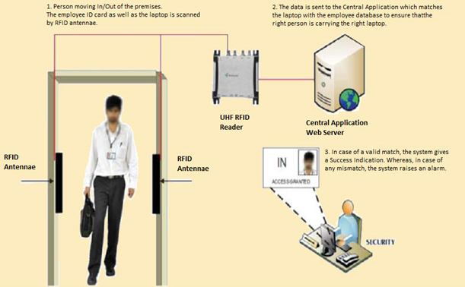
At the entry.

Slide 4
Employee in the car at factory gate.
Whenever a vehicle comes in front of the reader(glass of the vehicle must be open to read the data), it will read RFID tag and will push the data to Asset Tracking System.
A confirmation message will be there in form of tower light to send the confirmation to the user to understand the matched/unmatched data.
Centralized network to stallion application running server should be provided by Musashi Auto Parts India Pvt. Ltd.

Slide 5
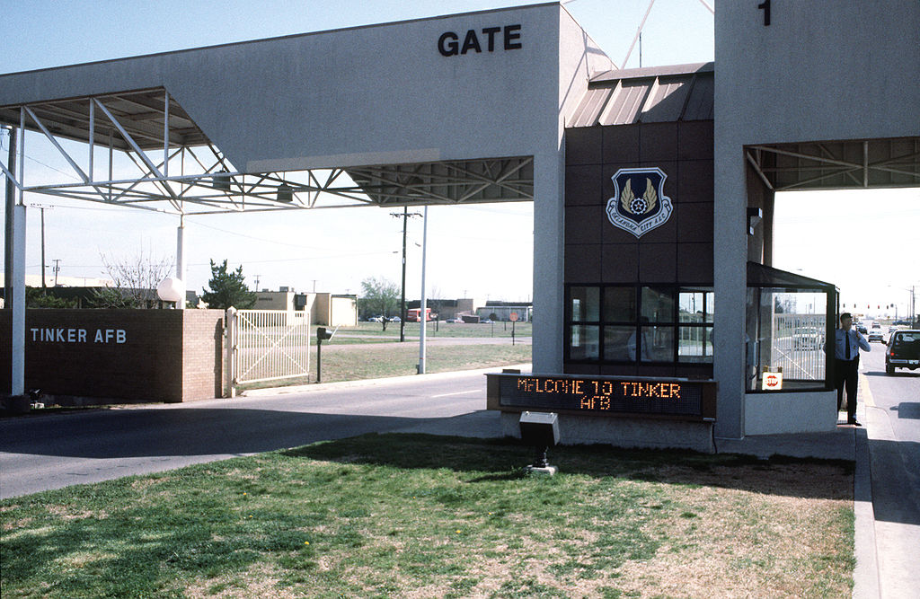


Slide 6
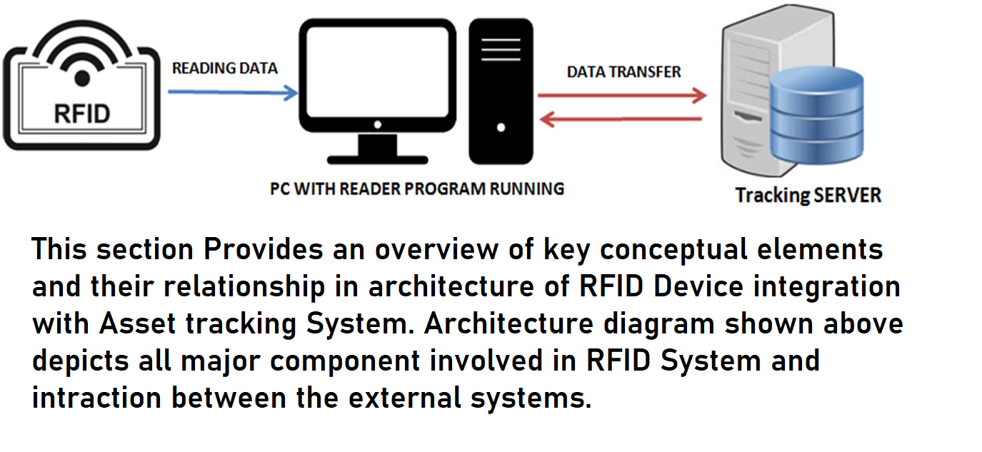
System Architecture

Slide 7
Architectural Constraints
Application will be developed in C# .NET.
Manage the database(MSSQL as per license)
Server Configuration
Minimum System requirement with – 6GB Ram,i5,Windows 8/10
500 GB Hard disk

Slide 8
Asset Tracking System Features
Asset tracking Application will replace the manual security checking.
Auto Identification of asset using RFID Tag
Live Tracking of asset inside the premises.
Will able to send mail in case of mismatch data.
Will provide the Monthly and Daily report.

Slide 9
Efforts Estimate for App Development
  Development Estimate
  Development Estimate
Activity | Working days
SRS Documentation | 02
Development & Testing | 20
User acceptance Test | 07
Implementation & Training for 1 location’s | 01
One-time charge for software implementation & training includes 1 location. | 30

Slide 10
Software Features
MASTERS | TRANSACTIONS | REPORTS
USER MASTER | DATA MAPPING | DAILY REPORT
DEVICE MASTER |  | MONTHLY REPORT
EMPLOYEE MASTER |  | EMPLOYEE REPORT

Slide 11
Bill Of Material
SNO. | PRODUCT CODE | PRODUCT DESCRIPTION | QTY.
1 | Impinj Reader | Impinj Fixed RFID R220 2 Port Reader | 4
2 | Power supply | POE Adapter | 4
3 | Antenna | STA AN86609C | 8
4 | RFID Desktop Reader | STA IR9816 USB Desktop Reader | 1
5 | Tower Light | Tower Light | 2
6 | Hooter | Buzzer Circuit | 2
7 | RFID Tags | RFID Asset Tags | 1

Slide 12
Thank You
THANK Y
For your wathcing

